Slide 2

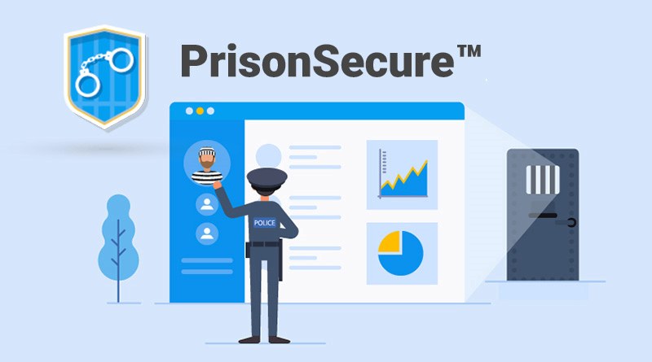
Project Title
Prisoner Surveillance Setup

Slide 3

Submitted By:
Name | Course | Roll No. | SAP Id
Aditya Sharma | BFSI | R133218002 | 500069141
Rishav Singh | BFSI | R133218035 | 500071526
Ritul Priya | BFSI | R133218020 | 500069262
Under the guidance of:-
Mr. Bhupesh Kumar Dewangan
Assistant Professor (Senior Scale), SOCS
Department Of Informatics
SCHOOL OF COMPUTER SCIENCE
UNIVERSITY OF PETROLEUM AND ENERGY STUDIES
Bidholi Campus, Energy Acres,Dehradun-248007

Slide 4
Index
Serial No. | Contents | Slide No.
1. | Abstract | 5-6
2. | Introduction | 7-8
3. | Motivation | 9-10
4. | Problem Statement | 11
5. | Objectives | 12
6. | Literature Review | 13-16
7. | Methodology | 17-28
8. | Plan of Work | 29
9. | System Requirements | 30
10. | Work done so far | 31
11. | References | 32

Slide 5

Abstract
Prison surveillance set-up is a governance system designed to compact the current security framework and minimize the time utilization of data collection in any criminal case or general inquiry.
It is equipped with a login constraint and required security credentials for any data modification.
Time stamping is recorded for every login in order to record data for the security analysis.
This setup is consisting three interface views which are admin, jail, and inquiry.
All the interface view will have different accessibility according to the user.

Slide 6
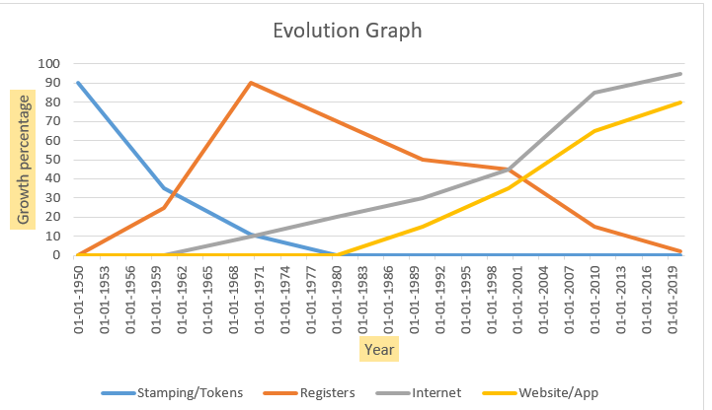
Evolution Of Prisoner Set-up
Scale:
X axis: Growth Percentage
Y axis: Year
Fig .1 Evolution in growth of prison setup
The above graph is between development in percentage and years. Basically,
this graph shows that how prison management era is increasing year by year \
in different Sectors

Slide 7

Introduction
We are making a single platform prison surveillance set up that is made for the Central level data where many tasks can be performed.
For the security layer, we have given grant access to the interfaces according to their need.
Firstly, we are making three interfaces in this setup which are 1.Administration Login 2. Police Login 3. Jailor Login.
There is a total of 3 login attempts provided for all the above three interfaces.
There will be a time stamping for every successful login and login details will be recorded for future security purpose.
A feature is provided with this setup that if any of the interfaces want to get the required document in the hard copy or soft copy, they can select the option of retrieve data.

Slide 8

Accessibility Distribution
Log-in
Administration Login
Police Login
Jailor Login
Prisoner Entry
Prisoner Attendance
Release Prisoner
Prisoner Details
Search Prisoner
Prison File
Log-in Record

Slide 9

Motivation
As we are making this project in C++, this project will help us in learning many concepts and algorithms.
By creating this project, it will help us in learning the basic understanding of Object-Oriented Programming (OOPs).
We will be learning about the file inclusion through C++.
Studying and implementing is the best way to learn and understand any concept.
This is basically for the learning purpose which will enhance our knowledge and skills for future projects.

Slide 10

Future Scope
In the future, this setup can be converted in Application which will help in the portability of using this system.
To increase the security basis we will add a One-Time Password (OTP) for every login attempt.
In the current scenario while interrogation of any criminal, they don’t tell the real identity of themselves and in maximum cases, the proof of identity id’s are also fake, so to solve this problem we will add a fingerprint scanner facility with the system.

Slide 11

Problem Statement
As per the present scenario, retrieving any details of criminal is a time taking process and to resolve this we are building a single platform prison surveillance set up that will help in improving the portability and security of the current system.

Slide 12


Objectives
Creating a single platform prisoner surveillance system.
Creating different interfaces for different types of user.
Fetching details of prisoner from files.
Applying login credentials inside the system
Applying string match algorithm.
Recording the real-time login stamp.
Integration of all the interfaces in a system.

Slide 13

Literature Review
In Paper[1] named as An object oriented intelligent tourist advisor system by C.H.K. Tsang,Dept. of Computer. & Math., Hong Kong Tech. Coll., Hong Kong M.H.C. Woo C. Bloor School of Computing and Information Systems, University of Sunderland, UK.
The paper describes the design and development of an expert system for a tourist information center. The expert system was built to recommend a suitable travel schedule that satisfies user input constraints such as time period, budget and preferences. Tourist center officers need to answer similar queries in their day-to-day work and could be replaced by an intelligent tourist advisor system.

Slide 14
Paper 2
In Paper [2] named as File Structures : An Object-Oriented Approach with C++ by Michael J. Folk Bill Zoellick Greg Riccardi which introduces the primary designed issues that characterize file structure design and notions of file structure literacy and of a conceptual toolkit for file structure design along with Introduction to file structure concepts dealing with reading , writing, field, record entries , inheritance, encapsulation etc.

Slide 15
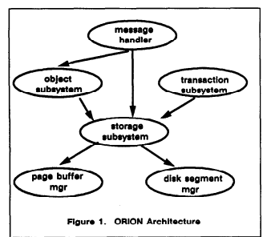
Paper 3
In Paper [3] named as Multimedia Information Management in an Object-Oriented Database System by Darrell Woelk Won Kim.
This paper describes the implementation of the Multimedia Information Manager (MIM) in the ORION object-oriented database system which is operational at MCC. We describe design objectives and implementation techniques that have satisfied the design objectives.
Fig 3. Orion Architecture
¹ Source - The above picture shows the graph of management system made in Object-Oriented Programming -https:cloudfront.net

Slide 16
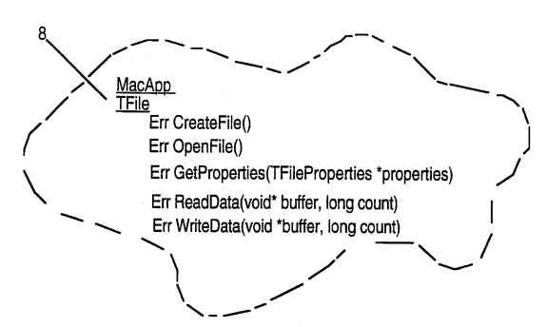
Paper 4
In Paper [4] named as Extensible object-oriented file system by Bryan P. Atsatt, Earsh K. Nandkeshwar, Michael J. Seilnacht, Hemantkumar A. Thakkar, George R. Turner and Roger R. Webster.
An object-oriented file system in an object-oriented operating system includes a file system entity class that is subclassed into a volume, directory and file subclass. These classes encapsulate standard file system properties such as name, creation date, and size, as well as standard operations such as create, open, close, and property accessors.
Fig 4. Extensible Object Oriented System
¹ Source - The above picture shows the extensible object-oriented file system - https://patents.google.com

Slide 17
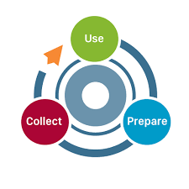
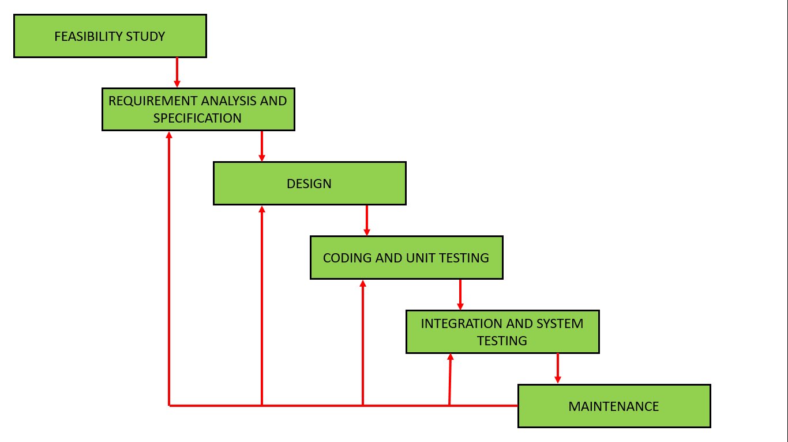
Methodology
We are using the iterative waterfall model for our project.
Fig 5. Feedback paths introduced by the iterative waterfall model are shown in the figure. ¹
¹ Source - The above picture shows the stages of iterative waterfall model retrieved from - https://www.geeksforgeeks.org

Slide 18
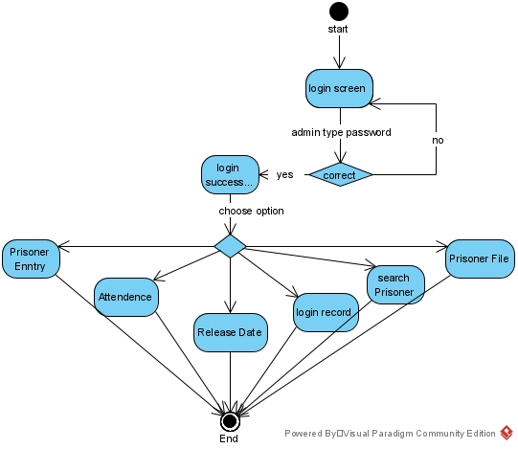
Functioning Of The System
Administration Login:
Fig 6.1 Functioning of the System

Slide 19
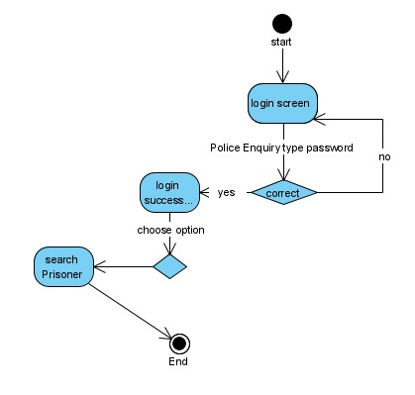
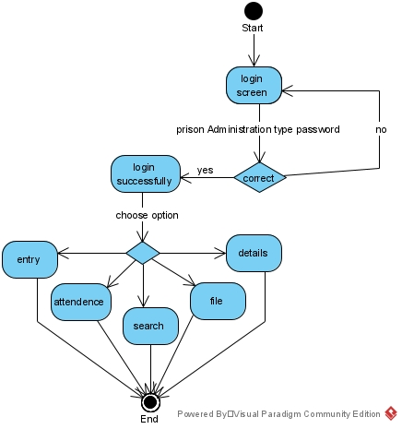
Police Enquiry Login
Jailor Login
Fig 6.2 Functioning of Police Enquiry Login
Fig 6.3 Functioning of Prisoner Administration Login

Slide 20
Concepts Used
Header Files:
Windows.h
iostream
String.h
ctime
Functions:
System(“cls”) - It clears the output screen of the program.
Time()- It returns the current time
Date()- It returns the current date
System(“pause”)- This is a Windows-specific command, which tells the OS to run the pause program.

Slide 21
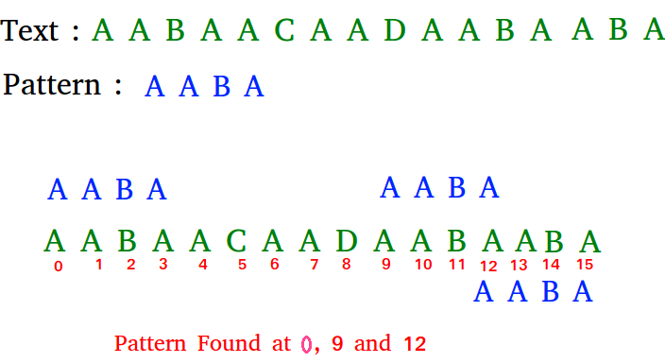
Algorithm
Naive Algorithm
Naive pattern searching is the simplest method among other pattern searching algorithms. It checks for all character of the main string to the pattern. This algorithm is helpful for smaller texts. It does not need any pre-processing phases. We can find substring by checking once for the string. It also does not occupy extra space to perform the operation.
Fig 7. Naïve Algorithm Example
¹ Source - The above picture shows the example of Naïve Algorithm - https://www.geeksforgeeks.org

Slide 22
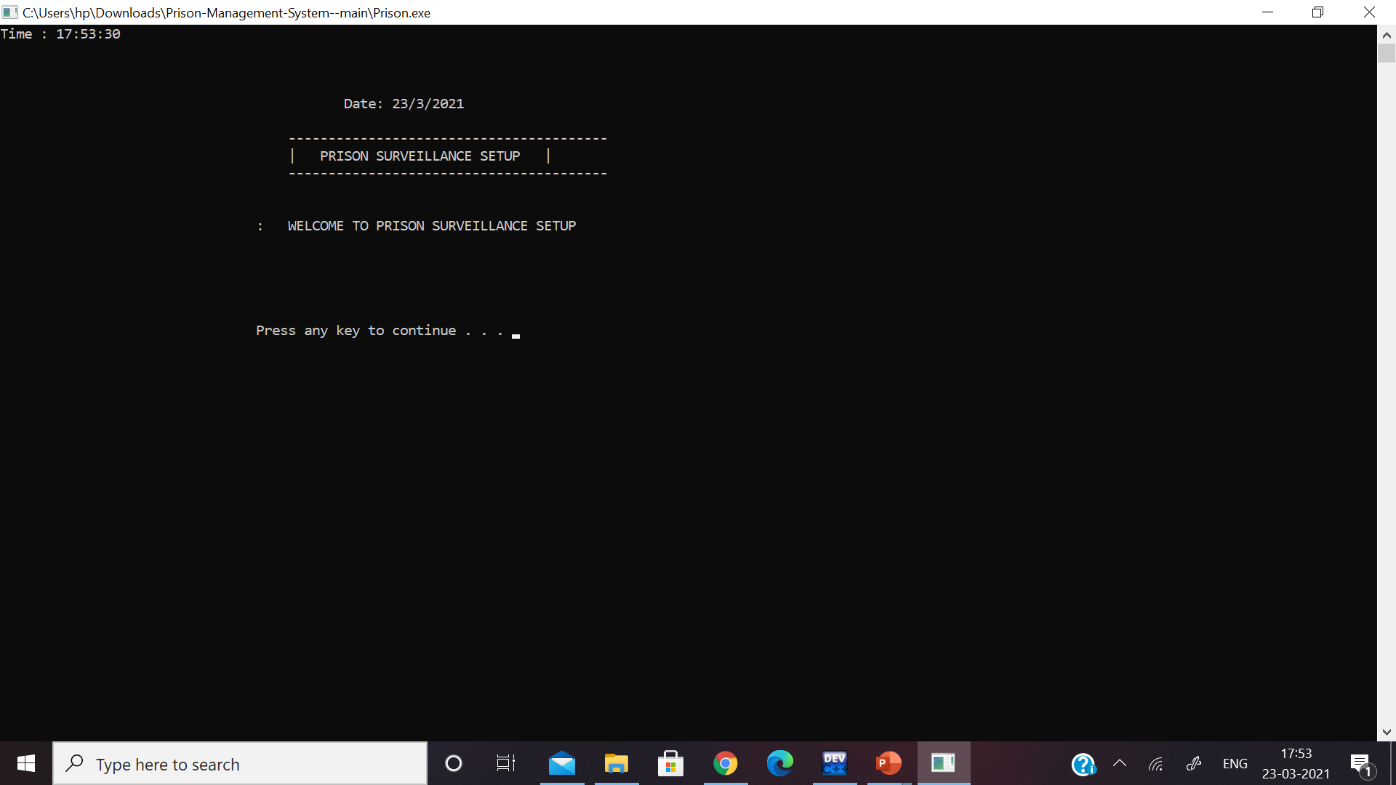
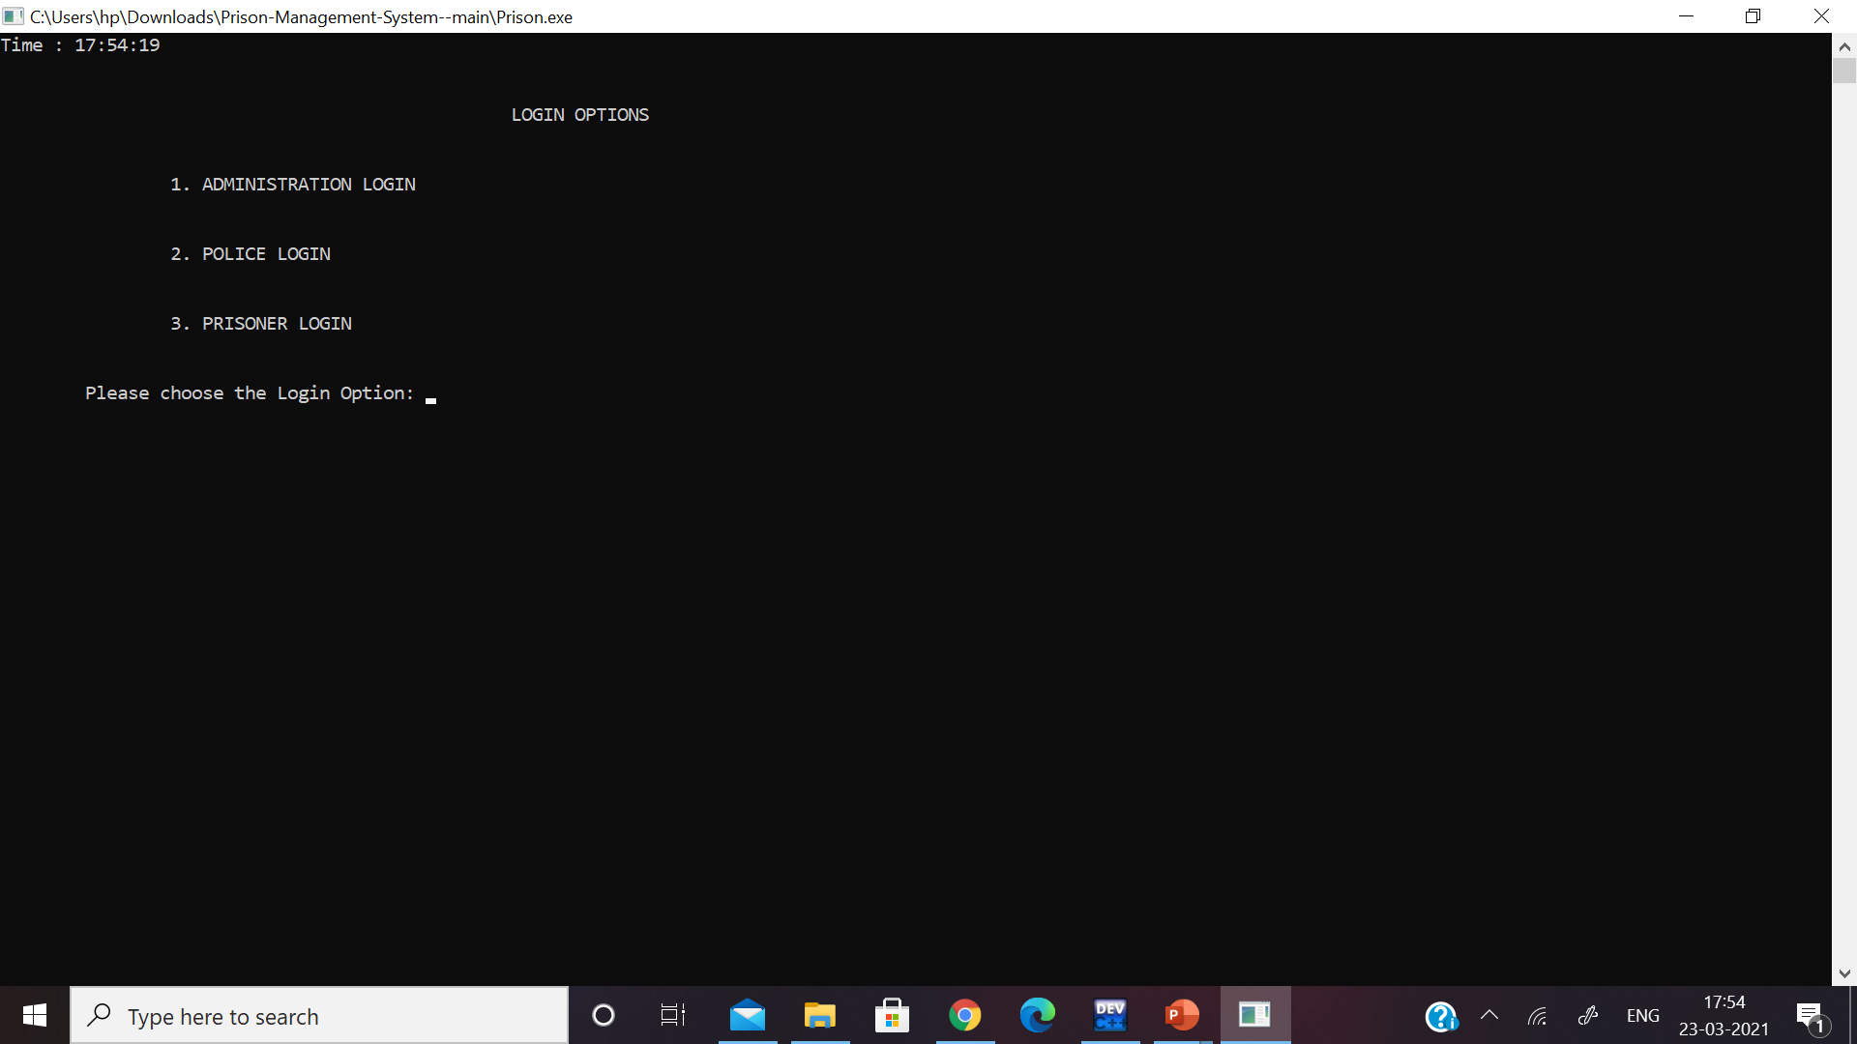
OUTPUTS
Fig 8.1: Output of the opening window
Fig 8.2: Output of the Main window

Slide 23
PSEUDOCODE OF ADMINISTRATION LOGIN
Step 1:- Import all the header files.
Step 2:- Declare main function
Int main ();
Step3 :- Display Login options .
Cout << 1. Administration login
2. police login
3. prisoner login
Cin >> 1.
Step 6:- declare variables
Char username, password;
Int try1;
Step 7:- Admin input user name and password
Cin >> username
Cin >> password
If ( user name = “user” && password = “ admin123”)
Then { access is granted
}
Else {
no. Of attempts remain : “ 3- try1”;}
If ( try1 >= 3)
{ no permission to enter the system }
Step 8:- After access to the system
Functions: 1. Set data
2. details
3. Release
4. Attendance
5. Search Prison
6. Prison File
7. Exit
8. Logout
Cin >> { 1,2,3,4,5,6}
Step 9 :- Logout
Step 4 :- Declare Administration login function
void Prison::Ad_Login()
Step 5 :- display welcome screen
print Welcome message

Slide 24
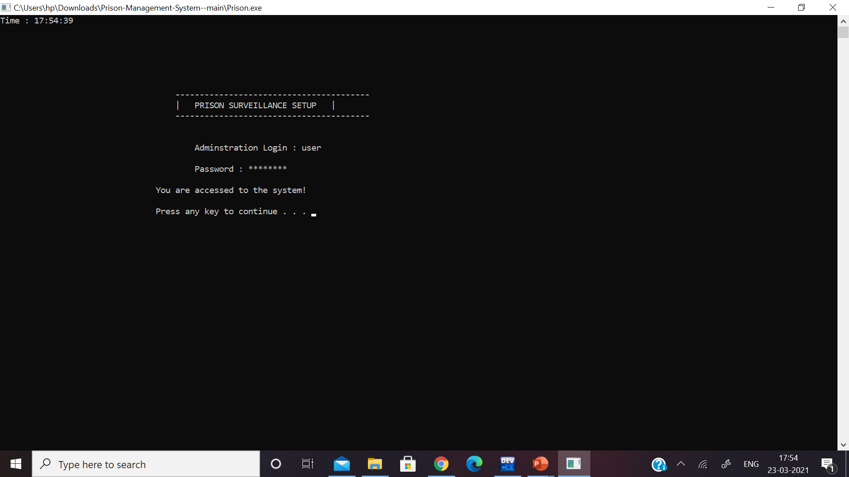
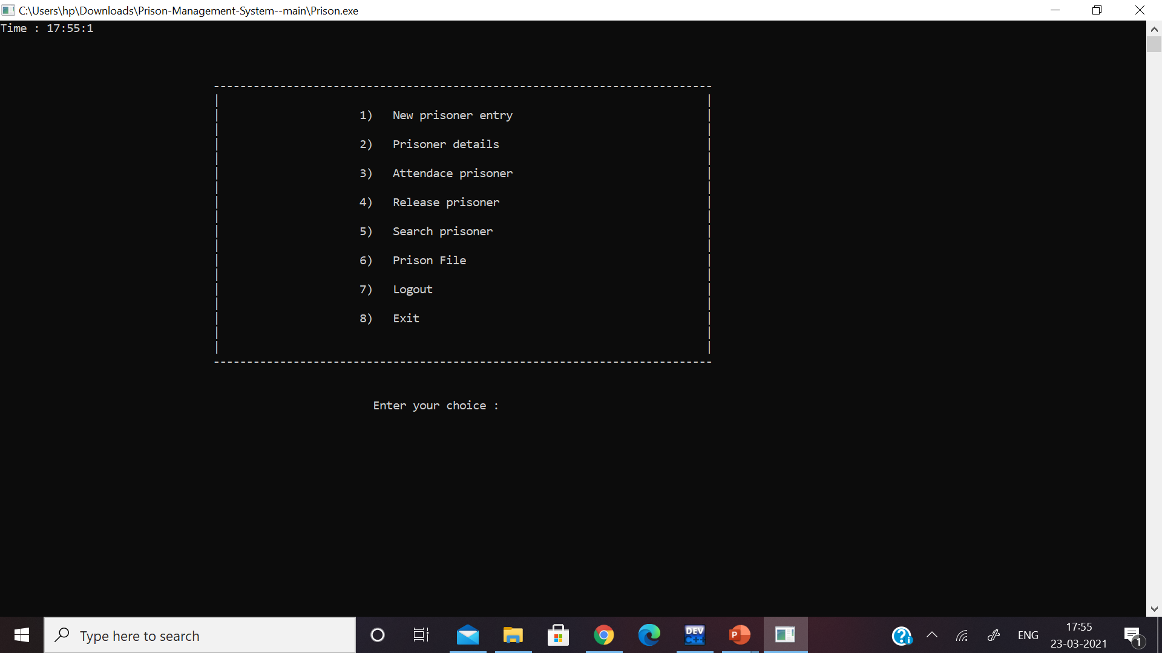
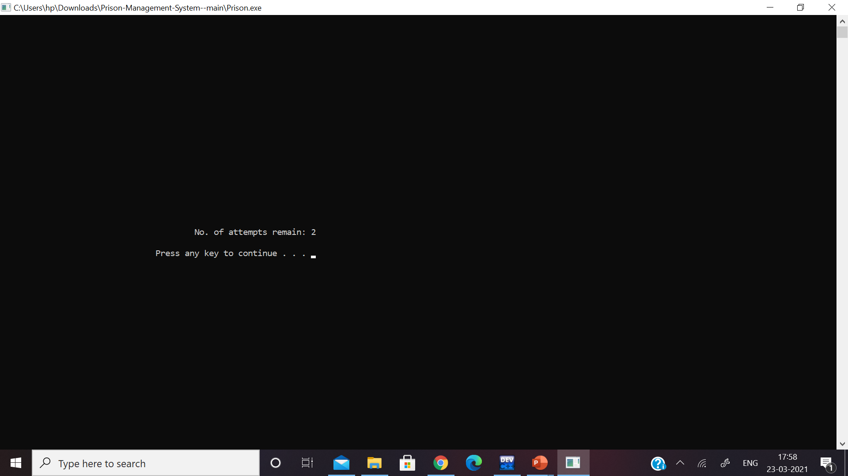
OUTPUT
Fig 9.1: Output of the Administration Login
Fig 9.3: Output of the Functions In the Administration Login
Fig 9.2: Output of the Failed attempt in Administration Login

Slide 25
PSEUDOCODE OF POLICE LOGIN
Step 1:- Import all the header files.
Step 2:- Declare main function
Int main ();
Step3 :- Display Login options .
Cout << 1. Administration login
2. police login
3. prisoner login
Cin >> 2.
Step 4 :- Declare Administration login function
void Prison::po_Login()
Step 5 :- display welcome screen
Cout<< Welcome prisoner Surveillance Setup
Step 6:- declare variables
Char username, password;
Int try1;
Step 8:- After access to the system
Cout<< 1. Search Prison
2. logout
3. Exit
Cin >> { 1,2,3}
Step 9 :- Logout.
Step 7:- Admin input user name and password
Cin >> username
Cin >> password
If ( user name = “police” && password = “ admin123”)
Then { access is granted}
Else {
no. Of attempts remain : “ 3- try1”;}

Slide 26

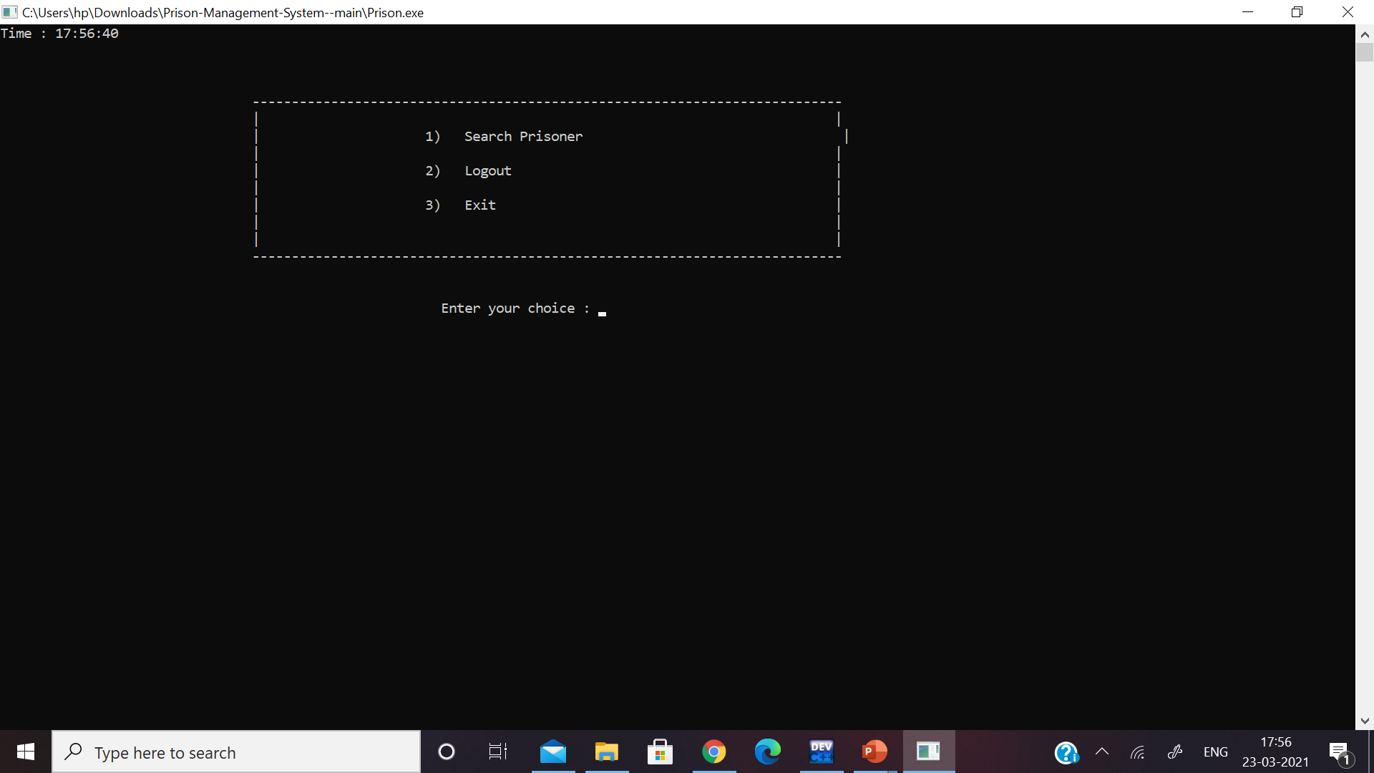
OUTPUT
Fig 9.1: Output of the Administration Login
Fig 10.1: Output of the Police Login
Fig 10.2: Output of the functions in Police Login

Slide 27
PSEUDOCODE OF JAILOR LOGIN
Step 1:- Import all the header files.
Step 2:- Declare main function
Int main ();
Step3 :- Display Login options .
Cout << 1. Administration login
2. police login
3. prisoner login
Cin >> 3
Step 6:- declare variables
Char username, password;
Int try1;
Step 7:- Admin input user name and password
Cin >> username
Cin >> password
If ( user name = “jailor” && password = “ admin123”)
Then { access is granted
}
Else {
no. Of attempts remain : “ 3- try1”;}
If ( try1 >= 3)
{ no permission to enter the system }
Step 8:- After access to the system
Functions: 1. Set data
2. details
3. Attendance
4. Search Prison
5. Prison File
6. Exit
7. Logout
Cin >> { 1,2,3,4,5,6}
Step 9 :- Logout
Step 4 :- Declare Jailor login function
void Prison::Pr_Login()
Step 5 :- display welcome screen
print Welcome message

Slide 28

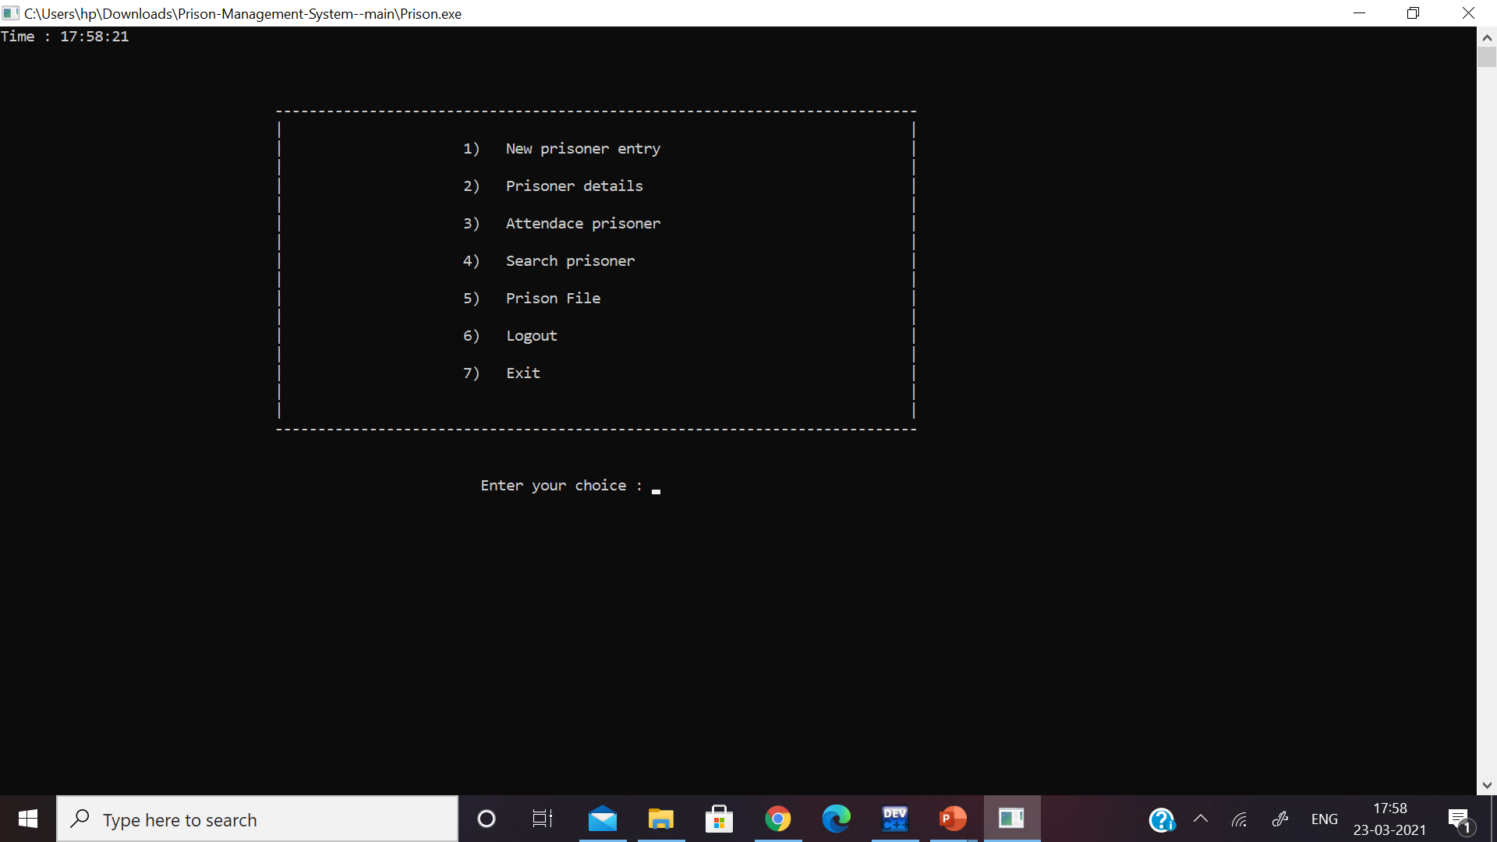
OUTPUT
Fig 11.1: Output of the Jailor Login
Fig 11.2 : Output of the functions Jailor Login

Slide 29

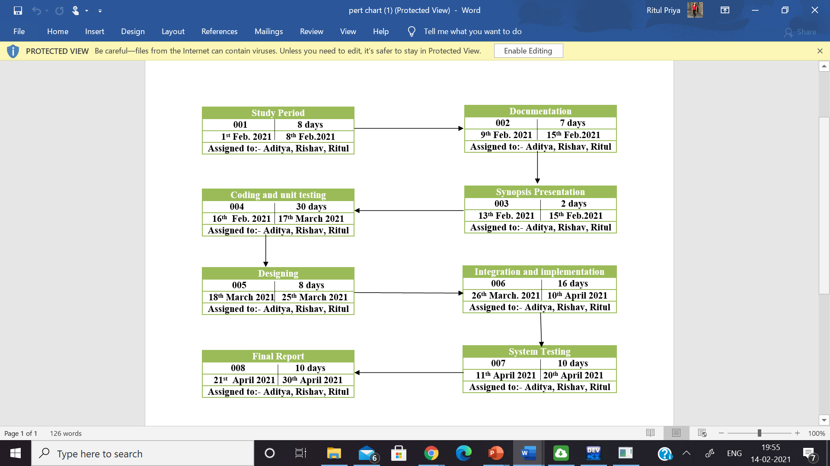
Plan of Work
Pert Chart:

Slide 30

System Requirements
Software Requirements
Name of Component | Specification
Operating System | Windows 10
Front End | C language
IDE Required | Dev C++
Hardware Requirements
Name of Component | Specification
Processor | Intel® Core™ i5-8250U CPU @ 1.60 GHZ 1.80 GH
RAM | 4 GB
Hard Disk | 1 TB

Slide 31
Work Done So far:
Work To Be Done:
Implementation of algorithm
Files handling
Integration
System testing
Documentation
Study analysis
Implementation of login credentials
Designing

Slide 32
References
[1] C.H.K Tsang, M.H.C Woo, C. Bloor. "An Object Oriented intelligent tourist advisor system“ https://ieeeexplore.org L.A – 12-02-2021 5:33 PM
[2] Michael J. Folk, Bill Zoellick, Greg Riccardi “An Object-Oriented Approach with C++”https://books.google.co.in L.A – 12-02-2021 6:07 PM
[3] Darrell Woelk, Won Kim “Multimedia Information Management in an Object-Oriented Database System” www.cloudfront.net – 12-02-2021 6:45 PM
[4] Bryan P. Atsatt, Earsh K. Nankeshwar, Michael J. Seilnacht, George R. Turner “Extensible Object-Oriented File system” https://patents.google.com – 13-02-2021 2:00 PM
[5] Tromp, J., Steed, A. & Wilson, J. R. (2003). Systematic usability evaluation and design issues for collaborative virtual environments. Presence, 12:3, 241-267https://www.researchgate.net L.A – 30-11-2020 4:30 PM
[6] https://pdfs.semanticscholar.org – 13-02-2021 4:50 PM
[7] Sayan K. Pal “Iterative Water Fall method” https://www.geeksforgeeks.org L.A – 13-02-2021 7:20 PM
[8] National Institute of correction “Prison Security ”https://nicic.gov L.A – 15-02-2021 5:30 PM
[9] Android Authority “Fingerprint Scanner working principle ”https://www.androidauthority.com L.A – 15-02-2021 7:00PM
[10] Dr. L.P RAJU “Historical Evolution of Prison System in India”www.worldwidejournals.com L.A – 15-02-2021 7:59 PM
[11] ] “Overview of Prisons in India” home.rajasthan.gov.in L.A – 15-02-2021 8:30 PM

Slide 33


